Slide 1

Java Mail
Dima Ionut Daniel

Slide 2
Contents
What is Java Mail?
Core
Advanced
MIME
Implementations
Bibliography

Slide 3

What is Jav Mail?
JavaMail is a Java API used to send and receive email via SMTP, POP3 and IMAP.
JavaMail is built into the Java EE platform, but also provides an optional package for use in Java SE.
The current version is 1.5.5, released in December 2015.

Slide 4
Core
The components are represented by abstract classes in the javax.mail package.
If we're using Java 5, we need to install the JavaBeans Activation Framework.
It’s bundled with the JDK starting in Java 6.

Slide 5
Core (cont.)
To send a message, we need to follow bello steps:
1. Place properties for the session in a Properties object.
2. Start a mail session with the Session.getInstance() method.
3. Create a new Message object, probably by instantiating one of its concrete subclasses.
4. Set the message’s From: address.
5. Set the message’s To: address.
6. Set the message’s Subject:.
7. Set the content of the message.
8. Get a Transport from the session.
9. Connect the transport to a named host using a username and password.
10. Send the message to all recipients over the transport.

Slide 6
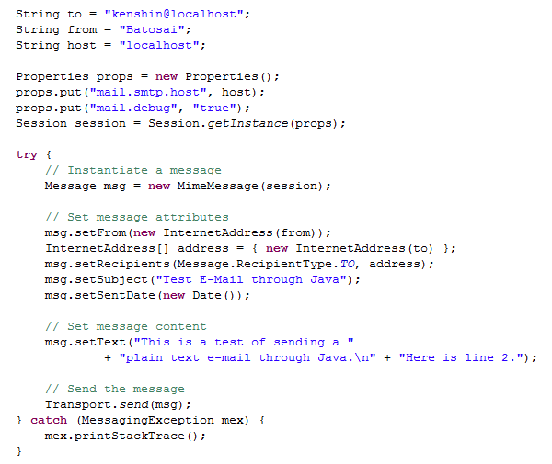
Core (cont.)

Slide 7
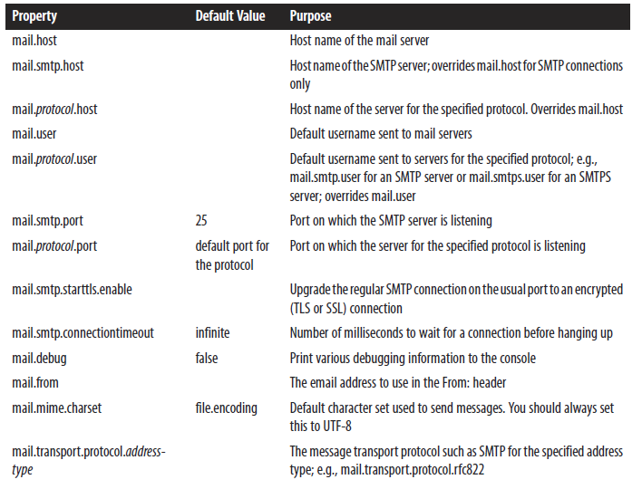
Core (cont.)

Slide 8
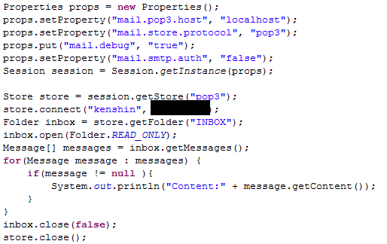
Core (cont.)
Java MAIL can be used to retrieve mails from remote mail servers.
Receiving mail is considerably more complex than sending it.
SMTP uses only 14 different commands, POP3 has 12 commands and IMAP4 has 24 different commands.

Slide 9
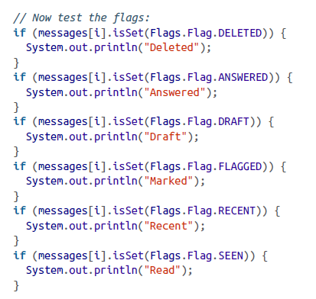
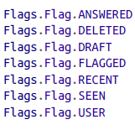
Advanced
The javax.mail.Message class is the abstract superclass for all individual emails.
Messages also have sent and received dates.
Mail programs can save extra information about the messages that are not part of the messages themselves.
In the JavaMail API, these are all represented as flags.

Slide 10
Advanced (cont.)
Messages received from the network belong to some Folder.
The getFolder() method returns a reference to the Folder object that contains this Message.
Many email programs can periodically check for incoming email in the background.
The JavaMail API defines six different kinds of mail events, all in the javax.mail.event package.
They are all subclasses of MailEvent.

Slide 11
Advanced (cont.)
The six concrete kinds of mail events are:
ConnectionEvent: A Folder, Store, or Transport has been opened, closed, or disconnected.
FolderEvent: A Folder has been created, deleted, or renamed.
MessageChangedEvent: The message’s envelope or flags have changed.
MessageCountEvent: A message was added to or deleted from a Folder.
StoreEvent: A notification or alert from a Store.
TransportEvent: A notification from a Transport that a message was delivered, partially delivered,
or failed to be delivered.

Slide 12
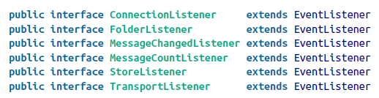


Advanced (cont.)
Customer Event listeners:

Slide 13
MIME
MIME and RFC822 are the standards for describing email messages that are sent across the Internet.
Yhe javax.mail.internet subpackage provides a complete implementation of these two packages.
MIME is specified by the following RFCs: RFC2045, RFC2046, RFC2047.

Slide 14
MIME (cont.)
Multipurpose Internet Mail Extensions (MIME) is an Internet standard that extends the format of email to support:
Text in character sets other than ASCII.
Non-text attachments: audio, video, images, application programs etc.
Message bodies with multiple parts.
Header information in non-ASCII character sets.

Slide 15
MIME (cont.)
MIME was designed mainly for SMTP, but the content types defined by MIME standards are used in communication protocols such as HTTP for the World Wide Web.
Clients use this content type or media type header to select an appropriate "player" application for the type of data the header indicates.

Slide 16
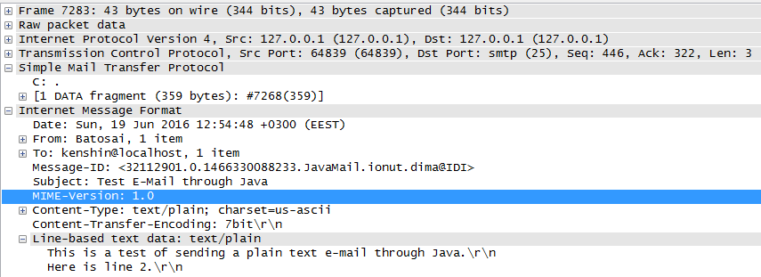
MIME (cont.)
The presence of "MIME-Version" header indicates the message is MIME-formatted.
The "Content-Type" header indicates the media type of the message content, consisting of a type and subtype.
The "content-disposition" header field was added in RFC 2183 to specify the presentation style.
The "content-transfer-encoding" MIME header indicates whether or not a binary-to-text encoding scheme has been used on top of the original encoding specified within the Content-Type header.

Slide 17
Implementations
Java Mail implementations:
JavaMail
Commons Email - built on top of JavaMail.
Spring Email integration

Slide 18
Implementations (cont.)
Commons Email aims to provide a API for sending email.
Some of the mail classes that are provided are as follows:
SimpleEmail - This class is used to send basic text based emails.
MultiPartEmail - This class is used to send multipart messages.
HtmlEmail - This class is used to send HTML formatted emails.
ImageHtmlEmail - This class is used to send HTML formatted emails with inline images.
EmailAttachment - This is a simple container class to allow for easy handling of attachments.

Slide 19
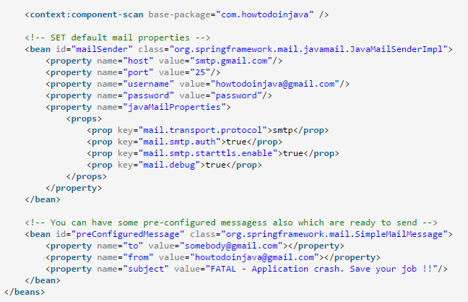
Implementations (cont.)

Slide 20
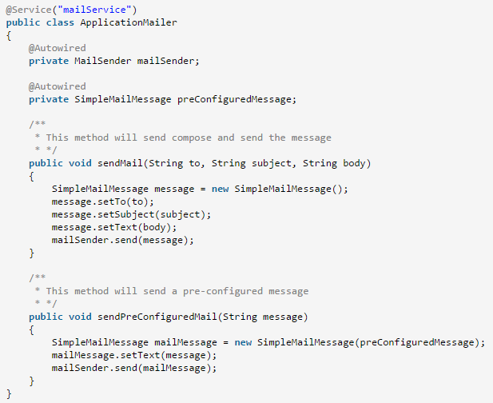
Implementations (cont.)

Slide 21

Bibliography
https://en.wikipedia.org/wiki/JavaMail
https://en.wikipedia.org/wiki/MIME
O’Reilly – Java Mail API
http://www.oracle.com/technetwork/java/faq-135477.html

